Slide 1
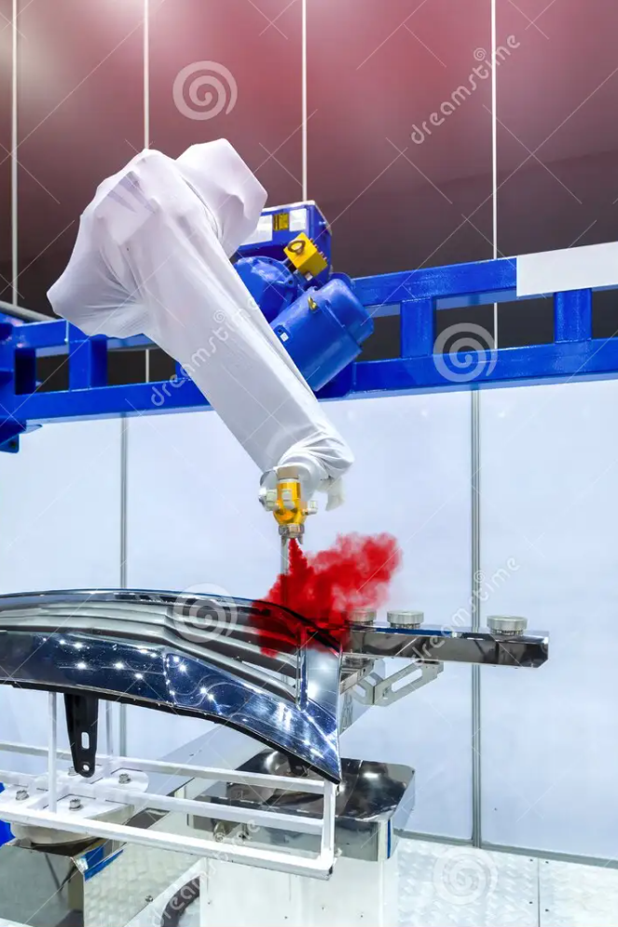
Revolutionizing Car Service Centers with Robotic Arms
1
Reduction in Human Errors and health hazards
Robotic arms eliminate the risk of accidents from fumes, chemicals, and repetitive motion, creating a safer work environment for everyone.
2
Increased Efficiency and Productivity
Robotic arms can work around the clock without getting tired and require minimal supervision, freeing up human workers for other tasks and improving overall efficiency.
3
Improved Quality and Precision
Robotic arms are programmed to apply the perfect amount of pressure and paint, resulting in a more uniform finish and fewer errors.

Slide 2
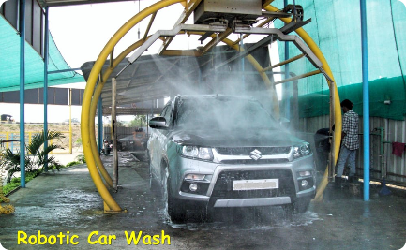
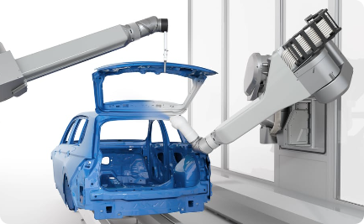
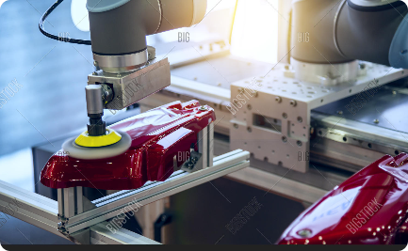
Applications of Robotic Arms
Surface Preparation and Cleaning
Primer and Base Coat Applications
Clear Coat and Finishing Touches
Robotic arms can efficiently and thoroughly clean car surfaces, removing dirt, oil, and other contaminants that can affect paint quality.
Robotic arms apply primer and base coats with precision, ensuring an even distribution and smooth finish that lasts.
Robotic arms can add clear coats and polish with incredible accuracy, producing a flawless shine and long-lasting protection.

Slide 3
Challenges in implementing Robotic Arms
1
Initial Investment and Budget Considerations
Car service centers must consider factors such as cost, return on investment, and long-term maintenance before implementing robotic arms.
Maintenance and Troubleshooting
2
Regular maintenance and calibration are crucial to prevent breakdowns and maximize efficiency. Proper troubleshooting techniques must also be in place to quickly address any issues that arise.

